Slide 1


Blazor: Client Side vs Server Side
Dr. Otto Dobretsberger

Slide 2
Agenda
MS Blazor – what is it?
Client Side vs Server Side
Code & Performance Demo
Q&A

Slide 3
MS Blazor
Interactive web UI with C# !
Reusable components built with C#, HTML, CSS
Can run directly in the browser using WebAssembly (real, actual .NET! – use existing .NET libraries!)
Can run on the server (use the same code!)
JavaScript Interop (use JS APIs and libraries)

Slide 4
MS Blazor – Client Side
SPA framework
WebAssembly (WASM): optimized bytecode format, open standard (runs without plugins)
Full browser functionality via JavaScript interop (WASM runs in the browser’s JavaScript sandbox)
C# code & razor files → .NET assemblies
Assemblies + .NET runtime downloaded (!) (can be cached)
WASM bootstraps .NET & loads assemblies
WASM uses JS interop for DOM manipulation & browser API calls

Slide 5
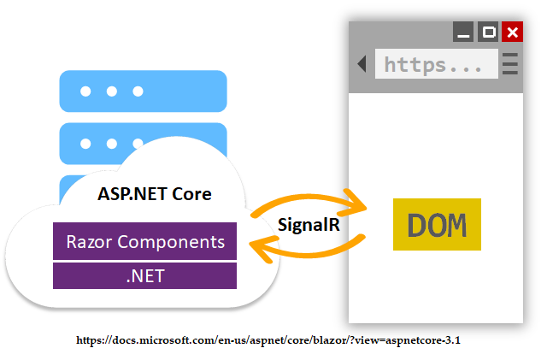
MS Blazor – Server Side
Razor components hosted in ASP.NET Core app server side
SignalR connection handles UI updates between server & browser
SignalR connection handles JS interop calls

Slide 6
Client Side
PROs:
+ .NET directly in browser (full stack C# !)
+ Theoretically faster than JavaScript (pre-compiled into WASM)
+ Works offline (PWA option)
CONs:
- Whole runtime needs to be downloaded
- No thin clients that are lacking WASM support
- Debugging options limited

Slide 7
Server Side
PROs:
+ Fully compatible with any .NET library (or tool)
+ Same syntax as client side Blazor
+ Heavy lifting done on server
+ Download size significantly smaller
+ Works with all thin clients (only HTML + JS to browser)
CONs:
- Network latency delays responses
- App uses more bandwidth
-.NET required on server
- Limit on simultaneous SignalR connections to Server

Slide 8
Code Demo
Dr. Otto Dobretsberger

Slide 9
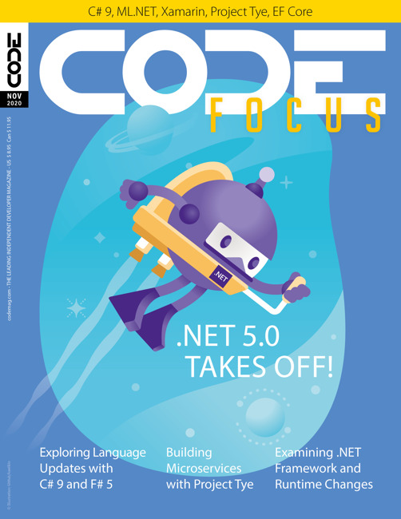
.NET 5 Blazor Announcement
.NET 5 Core Libraries
New Blazor WASM SDK
Improved WASM Runtime Performance
Virtualization
WASM Pre-Rendering
CSS Isolation
Debugging Improvements
Etc…
https://www.codemag.com/Article/2010102/Blazor-Updates-in-.NET-5

Slide 10
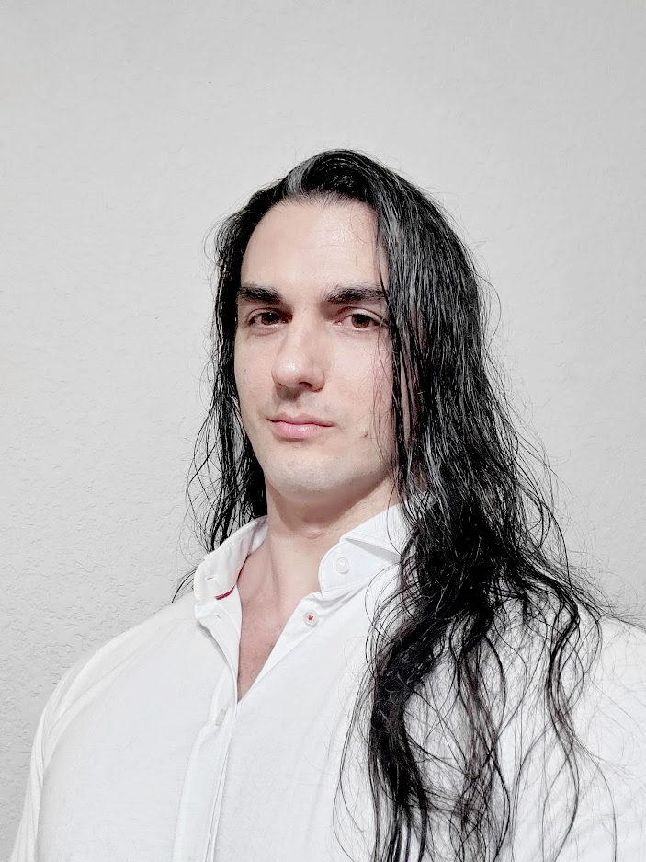

Presenter contact:
Senior Software Dev @ CODE Consulting
Professor at University of Houston
PhD in Computer Science (University of Houston)
Dr. Otto Dobretsberger
ottod@codemag.com

Slide 11

Thanks for joining!

